Slide 1

Dashboard

Slide 2
What is a Dashboard?
A dashboard is a consolidated display of many worksheets and related information in a single place.
It is used to compare and monitor a variety of data simultaneously.
The different data views are displayed all at once.
Dashboard is a collection of several views, letting us compare a variety of data simultaneously.

Slide 3
Dashboards can be accessed from tabs at the bottom of a workbook or from the Dashboard option on the menu bar.
While creating a dashboard, we can add views from any worksheet in the workbook along with many supporting objects such as text areas, web pages, and images.
Data in the sheets and dashboards is connected; when we modify a sheet, any dashboard containing it change, and vice versa.

Slide 4
Dashboards versus Data Visualizations
Data visualization is a way of presenting data in a visual form to make it easier to understand and analyze.
Dashboards are a summary of different, but related data sets, presented in a way that makes the related information easier to understand.
Dashboards are a type of data visualization, and often use common visualization tools such as graphs, charts, and tables.
Dashboards take data from different sources and aggregate it so ,non-technical people can more easily read and interpret it.
The main use of a dashboard is to show a comprehensive overview of data from different sources.

Slide 5
How to create a data dashboard
Here are important steps to help you build a dashboard:
Define your audience and goals: Ask who you are building this dashboard for and what do they need to understand? Once you know that, you can answer their questions more easily with selected visualizations and data.
Choose your data: Most businesses have plenty of data from different sources. Choose only what’s relevant to your audience.
Double-check your data: Always make sure your data is clean and correct before building a dashboard
Choose your visualizations: There are many different types of visualizations to use, such as charts, graphs, maps, etc. Choose the best one to represent your data.

Slide 6
Use a template: When building a dashboard for the first time, use a template or in-built software to save time and headaches. Carefully choose the best one for your project and don’t try to shoehorn data into a template that doesn’t work.
Keep it simple: Use similar colors and styles so your dashboard doesn’t become messy.
Iterate and improve: Once your dashboard is in a good place, ask for feedback from a specific person in your core audience.
Find out if it makes sense to them and answers their questions.
Take that feedback to heart and make improvements for better adoption and
understanding.

Slide 7
In Dashboard we can see
Size
Sheets
Objects
Dashboard Objects
1. Horizontal & vertical containers :
Containers group up related objects (Chart, images, text…) together.
Once we change the size, position or format of the container all objects within the container will be adjust automatically.
Horizontal container holds the items side by side. i.e. from left to right
Vertical Container from top to bottom
2. Text objects: can provide headers, explanations, and other information.
Text objects are simply text boxes that can be formatted and styled to your preference.
Text objects are great for headers, captions, footnotes, or any other need for text that is separate from a sheet.
You also can make Text objects dynamic by inserting parameter values.

Slide 8
Image object :
Use them for background images, buttons, navigation panes, custom alerts and more.
You can link your Image object to an image file saved on your computer, or to a URL of an image online.
Blank Object:
Help us to adjust spacing between dashboard items.
Whether you would like to add more white space to your dashboard design, want a thin colored line as a divider, or need a quick fix to hide a dashboard element from users, Blank objects can do it all.
Blank dashboard objects are truly just empty objects that can be any color, size or transparency you need.
Web Page object
Web Page objects function as mini web browsers within your dashboard, and can be static or dynamic.
Display the target pages in the context of your dashboard.

Slide 9
We have 2 different options how to arrange the objects in side the dashboard
Tiled
Floating
By default Tiled. Here objects automatically arranged , don’t overlap, resized based on overall dashboard size.
Floating: objects can be overlapped, flexible, but size and position should be managed manually.

Slide 10
Device Designer:
This feature takes a master dashboard and let you preview, and more importantly customize, what that dashboard would look like on a Desktop, tablet or phone.
Click on “ Device Preview” to bring up the Device Preview Bar.
There is the device type, with options including Default, Desktop, Tablet and Phone.
Depending on what device is selected, the model has a list of common models and their dimensions.
There is also a screen orientation.

Slide 11
Dashboard Sizing Options
Fixed size (Default): The dashboard remains the same size, regardless of the size of the window used to display it.
If dashboard is larger than the window, it becomes scrollable.
Range: The dashboard scales between minimum and maximum sizes that you specify.
If the window used to display the dashboard is smaller than the minimum size, scroll bars are displayed.
If it is larger than the maximum size, white space is displayed.
Automatic: The dashboard automatically resizes to fill the window used to display it.

Slide 12
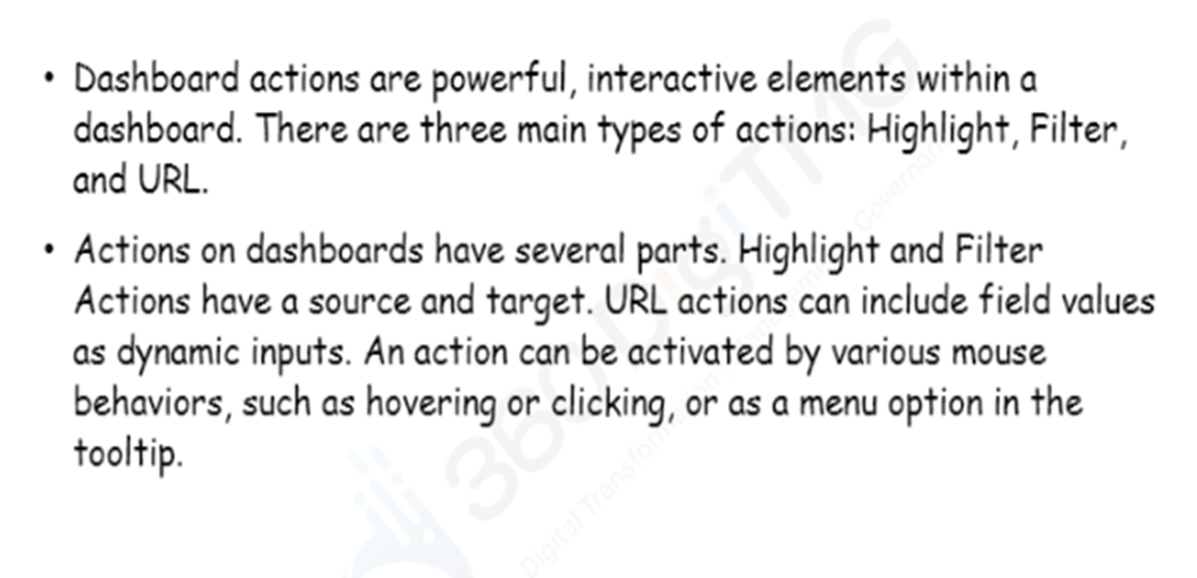
Dashboard Action

Slide 13
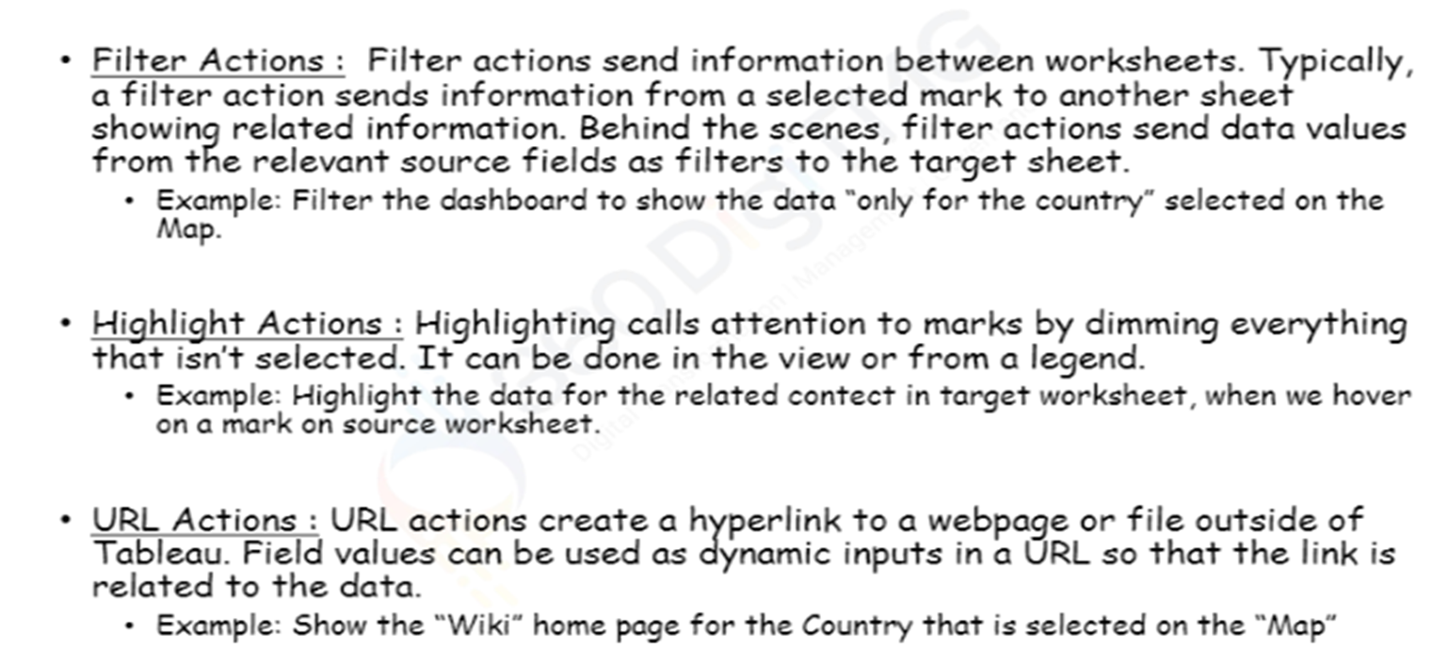
Dashboard Action

Slide 14
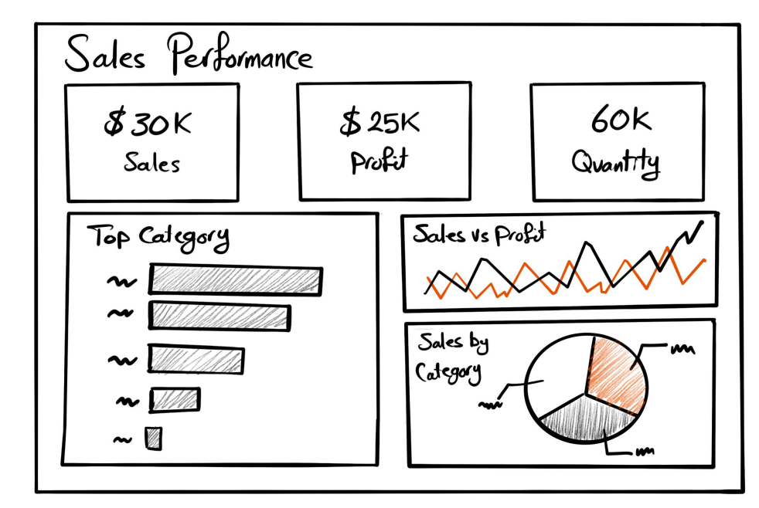
How to create Dashboard : Dashboard Mock-up

Slide 15
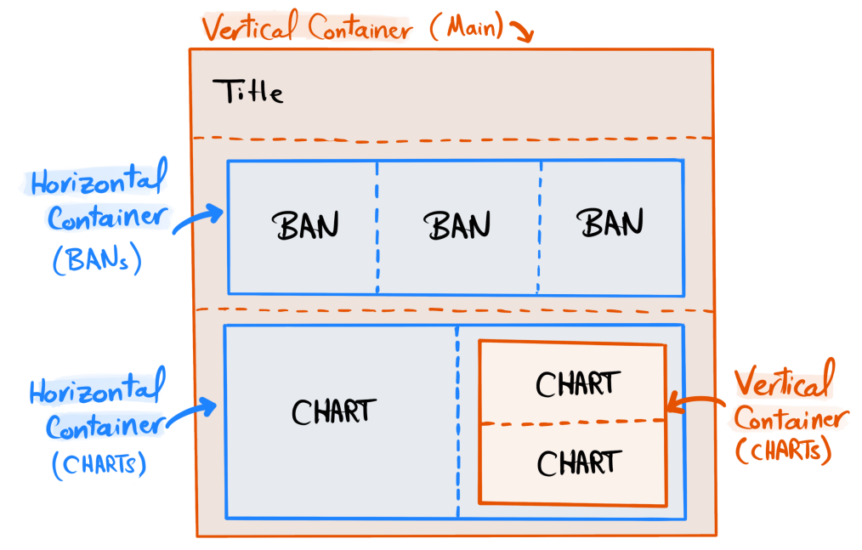
Container Mock-up

Slide 16
Creating a Dashboard
Sheet 1: Sales_info
Place sales on Text and detail.
Profit_info:
Profit on Text
Quantity _info
Profit on Text and Quantity on Text
Top Sub category
Sales on Columns
Sub category on Rows
Sales on color
Sales VS Profit
Quarter(Order date) on columns [Right click on it and choose Quarter2015]
Sales and Profit on Rows
Measure names on Color
Sales by category
Category on color
Sales on size
Sales on text
Now Click on Dash Board

Slide 17
Creating a Dashboard
Using the Sample-superstore, create a dashboard showing the sales and profits for different segments and Sub-Category of products across all the states.
Step 1 − Create a blank worksheet by using the add worksheet icon located at the bottom of the workbook.
Drag the dimension Segment to the columns shelf and the dimension Sub-Category to the Rows Shelf.
Drag and drop the measure Sales to the Color shelf and the measure Profit to the Size shelf.
This worksheet is referred as the Master worksheet.
Right-click and rename this worksheet as Sales_Profits.

Slide 18
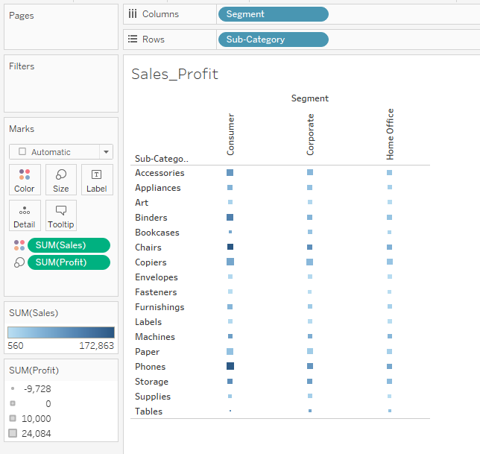

Slide 19
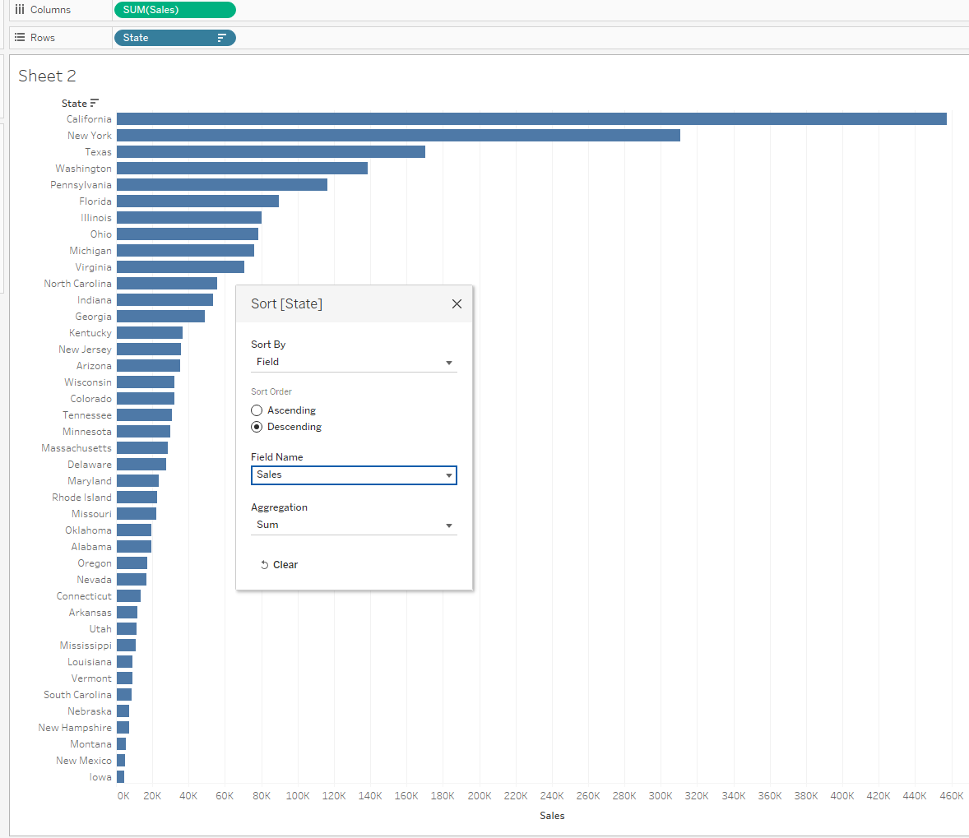
Step 2 − Create another sheet to hold the details of the Sales across the States.
For this, drag the dimension State to the Rows shelf and the measure Sales to the Columns shelf.
Next, apply a filter to the State field to arrange the Sales in a descending order.
Right-click and rename this worksheet as Sales_state.

Slide 20
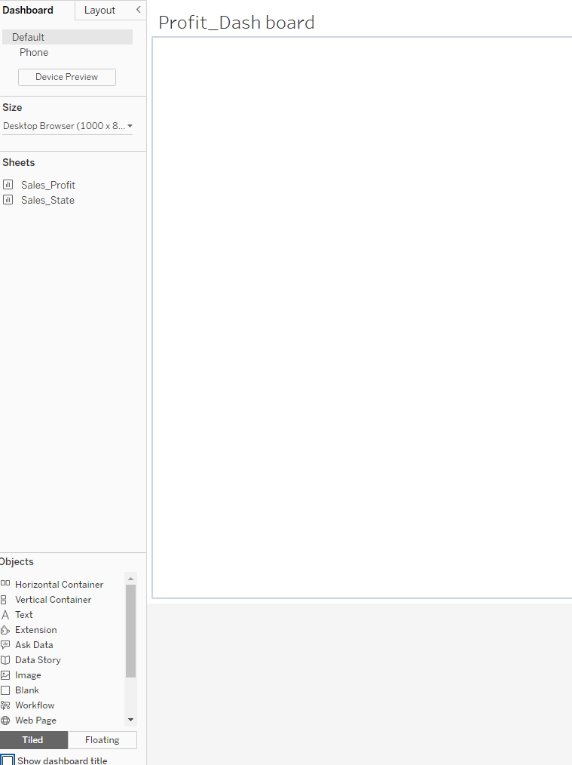
Step 3 − Next, create a blank dashboard by clicking the Create New Dashboard link at the bottom of the workbook.
Right-click and rename the dashboard as Profit_Dashboard.

Slide 21
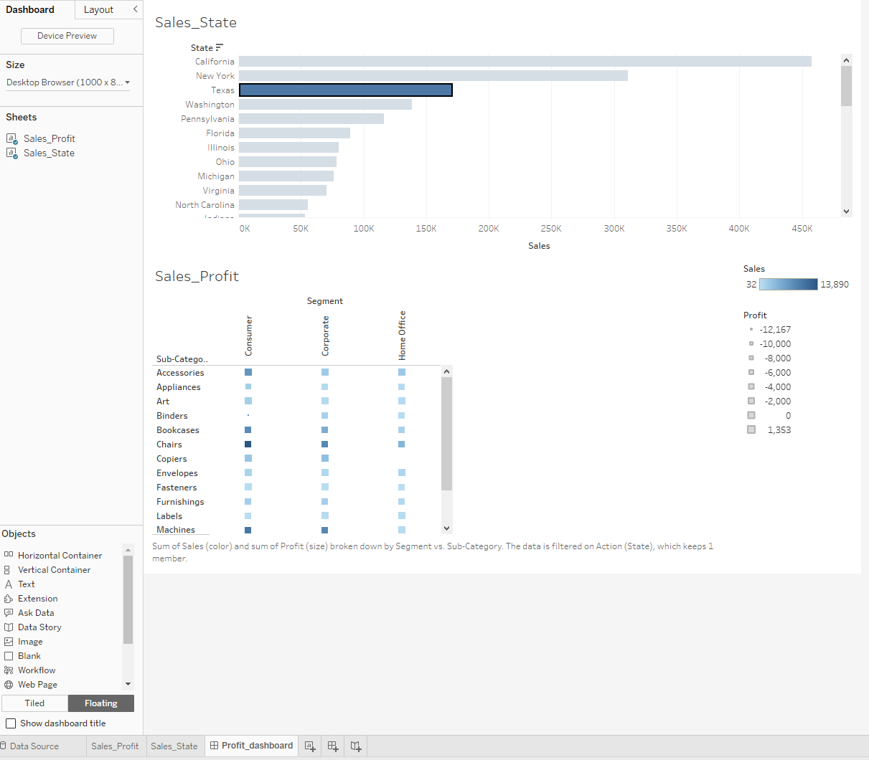
Step 4 − Drag the two worksheets to the dashboard. Near the top border line of Sales Profit worksheet, you can see three small icons.
Click the middle one, which shows the prompt Use as Filter on flying the mouse over it.

Slide 22
Step 5 − Now in the dashboard, click the box representing Sub-Category named Machines and segment named Consumer.
You can notice that only the states where the sales happened for this amount of profit are filtered out in the right pane named Sales_state.
This illustrates how the sheets are linked in a dashboard.

Slide 23
Actions in Tableau Dashboard
Actions allows us to add interactivity to our dash board.
Actions in tableau are elements that a user can add to its dashboard, driven by the data from within the worksheets.
This allows the users to directly interact with the visualizations and control various aspects of the data analysis.
Ex: we can add logic that says “ if a user clicks on Dashboard sheet1, and want something to happen on Dashboard sheet2 use actions.”
We can find this option when go to worksheet Menu or in Dashboard Menu also.
Tableau supports different types of actions
Filter
Highlight
Go to URL
Go to Sheet
Change parameters
Change set values

Slide 24
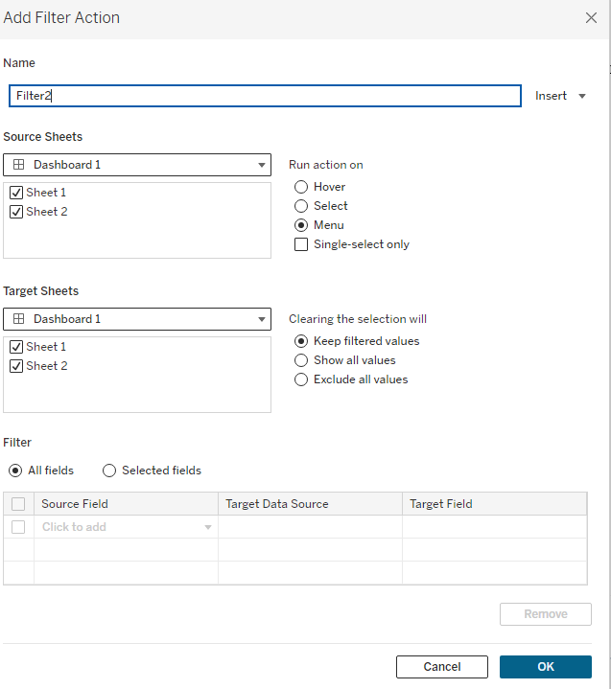
Filter Action : used to filter different charts and use the drill-down method in Tableau.
Ex: If we click on sheet1, sheet2 will be filtered to whatever you clicked on sheet1.
2. Highlight Action: Highlight actions allow you to call attention to marks of interest by coloring specific marks and dimming all others.
Ex: If you click on sheet1, sheet2 will be highlighted by whatever you clicked on sheet1.
3. URL Action: Links your visualization with the web page or another dashboard on the tableau server.
Ex: if you click on sheet1, open a URL

Slide 25
Source Sheet: List out all sheets you have on the dashboard. Where you are adding the action.
Any sheet selected in this list will cause the dashboard action to execute.
Target Sheet: List also shows all o f the sheets in the dashboard, but these are sheets where you want the action to take place.
Few Options: you can have action execute on 3 different interactions
Hover: If you hover over the source sheet, the action will take place on the target sheet.
Select: if you click on the source sheet, the action will take place on the target sheet.
Menu: if you hover over the source sheet, a menu of dashboard actions will appear in the tool tip. Clicking on one of the menu items will execute the action on the target sheet.

Slide 26
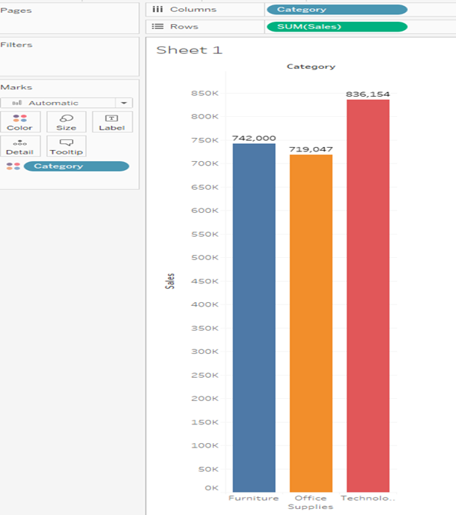
Steps to implement Tableau’s Actions
Launch Tableau Desktop and choose the ‘Connect to Data’ option from the data panel on the interface’s left side.
Access the spreadsheet, load the sample dataset and connect the tables (sheet1).
Hover over the sheets in the bottom-left corner of the interface once the data has loaded, then add a new sheet for the Product Category Sales (PC-sales).
Drag and drop the Category and Sales variables into the appropriate rows and columns beneath the toolbar by doing so in the tables section.

Slide 27
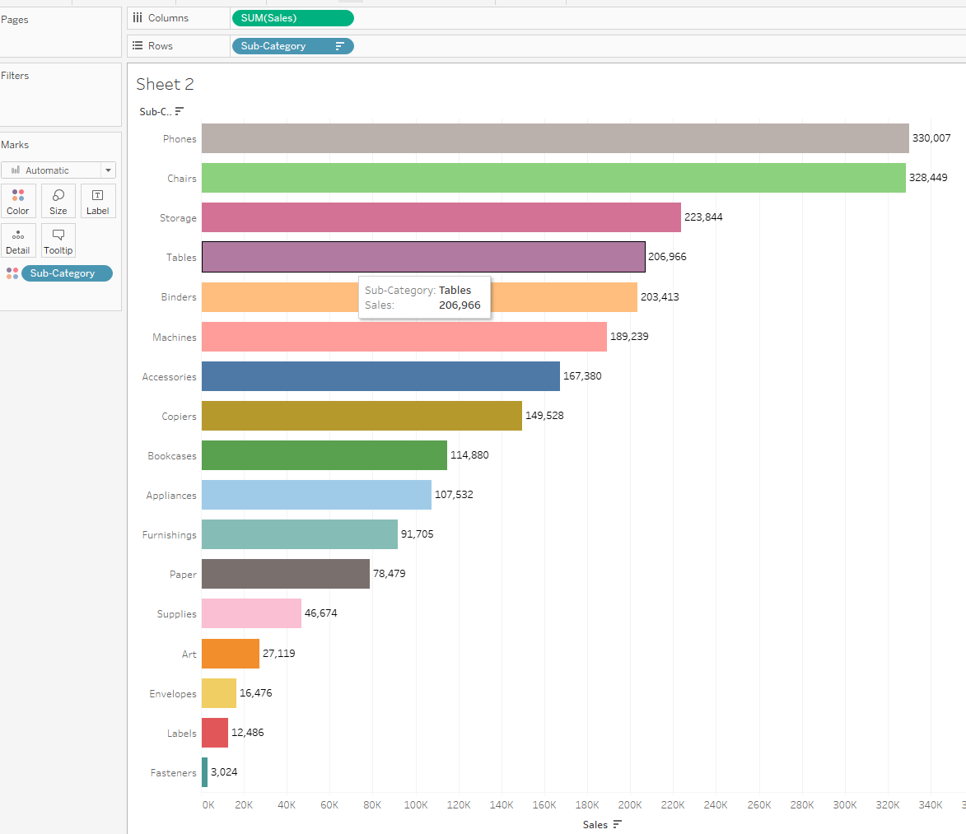
Steps to implement Tableau’s Actions contd.,
Step 5 : Add a new sheet for the Product-Sub-Category Sales after that (PSC-sales).

Slide 28
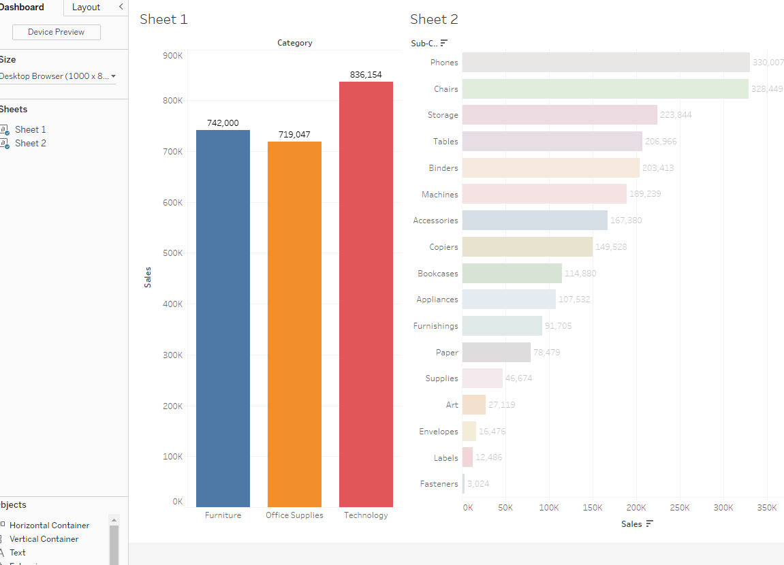
Filter Actions in Tableau
Events in one sheet are sparked by the filter actions, and the outcomes are displayed in the other.
Therefore, these are the steps to creating a tableau filter action :
Step 1 : Click on Dashboard and drag two sheets on dashboard

Slide 29
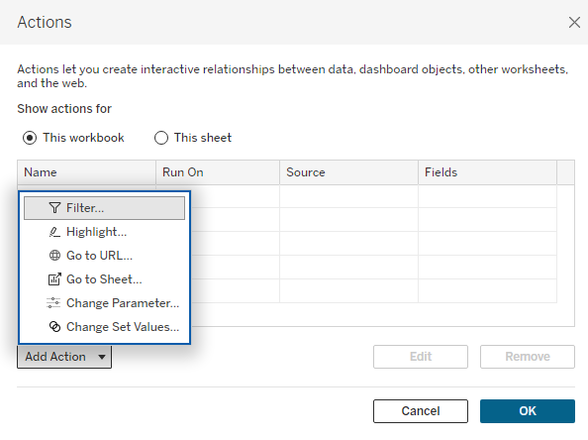
Filter Actions in Tableau
Step 2: Select Filter from the Add actions menu under Dashboard>> Actions.
Step 3: The “Add Filter Action” dialog box will display once you click “OK.” From here, you can choose the trigger on which you want to conduct your action as well as the sources and target sheets.

Slide 30
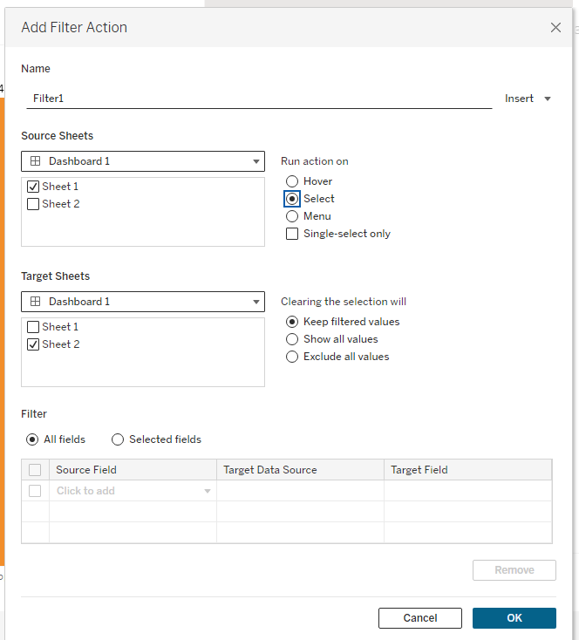
Filter Actions in Tableau
Step 4: select filter then window will open

Slide 31
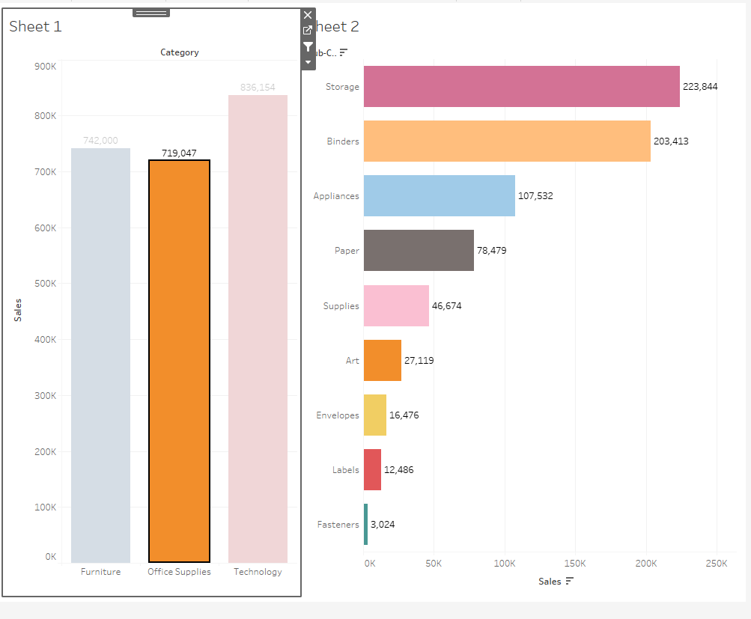
Filter Actions in Tableau
Step 5: once choose source and target sheet click ok
Step 6: now in sheet 1 click on one category, , in second sheet only those subcategory will display.

Slide 32
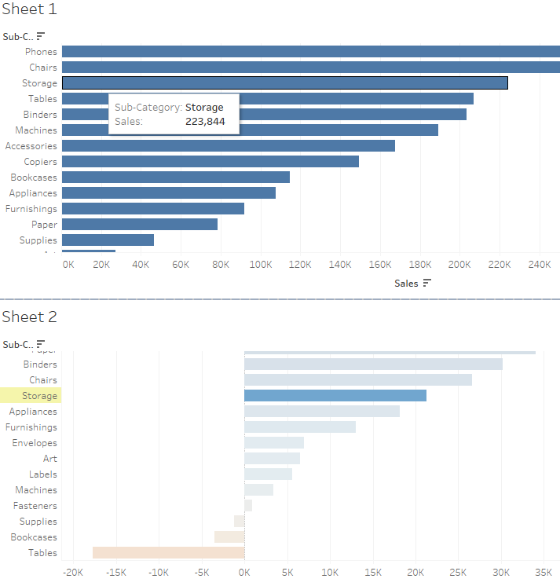
Highlight Actions in Tableau : Select the data from one sheet will highlights data on another sheet.
Create sheet 1 : by drag sales on column and sub category on rows
Create sheet2 by drag profit on column and subcategory on rows
Now create Dashboard and drag 2 sheets in to the dash board
In Menu bar Dashboard→ action → choose highlight
5. then choose Source page { running action on Hover] and target page and click ok

Slide 33
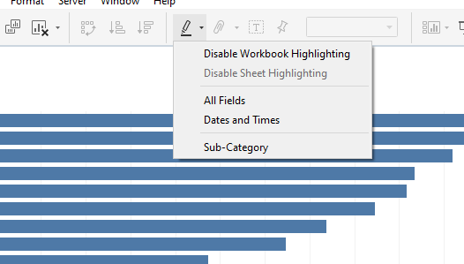
Highlight Actions in Tableau :
If we can also to highlight both sheets by one another.
If we want to disable hightlights

